Slide 1

Workshop: Cyber Safety
Alabama P.E.O. Workshop
                May 2023
Notes:
Welcome to our Cyber Safety workshop.
While cyber scams are not new, we have recently seen an uptick in cyber scams in P.E.O. Today, we will review specific cyber scams and how to protect yourself from these scams not only in P.E.O. but in your home and work life, too.

Slide 2

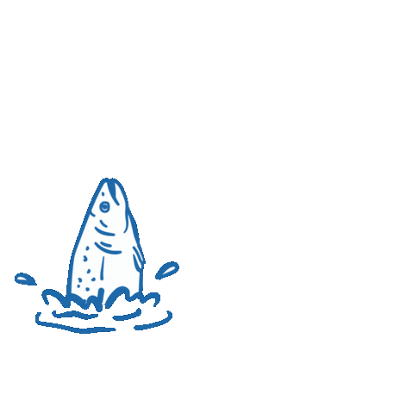
Phishing: A type of cyber attack during which malicious actors send messages pretending to be a trusted person or entity
What is
Phishing?
2
Notes:
Let’s focus on Phishing. What is Phishing?
It is a type of cyber attack where unwelcomed messages, either by email, phone or text, are sent pretending to be a trusted person. The attacker is attempting to steal confidential information such as login credentials, card details or passwords. They can request money or gift cards to sources we hold dear and use them for themselves. These attackers are very good at their jobs. They are able to make the requests look very real. We need to be vigilant in looking for poor spelling, grammar mistakes, incomplete sentence structure, etc. as most phishing is generated outside of the USA and Canada. These phishing attacks will also come unexpectedly, with usually an urgency to them.

Slide 3




Email phishing
The attacker sends an email pretending to be someone trustworthy and familiar (bank, social media company, Alabama P.E.O. State President, your Local Chapter President, etc.), and asks you to click a link, or perhaps download an attachment, verify a password, or send a copy of your chapter yearbook.
Clone phishing
In this attack, criminals make a copy or clone of previously delivered but legitimate emails that contain either a link or an attachment.
Vishing (voice call phishing)
This is a phone-based phishing attempt. The phisher calls claiming to represent your local bank, the police, the IRS, or even P.E.O. International. Next, they scare you with some sort of problem and insist you clear it up immediately by sharing your account information or paying a fine.
Cat phishing
This is phishing with a romantic twist. It is a type of online deception wherein a person creates a presence on a social network as a fictional online person for the purpose of luring someone into a relationship—usually a romantic one.
Types of Phishing
3
Notes:
There are many kinds of phishing. Let’s review some of them. They may not all apply to you or to P.E.O. but are worthy of discussion.
READ SLIDE

Slide 4



Spear phishing
This type attacks a specific person or organization, often with content that is tailor-made for the victim or victims. It requires pre-attack research to uncover names, job titles, email addresses, and the like. The hackers scour the Internet to match up this information with other researched knowledge about the target's colleagues, along with the names and relationships of key employees or volunteers in their organizations. As an example, think of the recent letters regarding Cottey students, requesting gift cards.
Whale phishing
Whale phishing targets high-profile victims. This can include celebrities, politicians, and CEOs. Typically, the attacker is trying to trick these well-known targets into giving personal information and/or business credentials.
Smishing (SMS phishing)
SMS, or texting, is another avenue of scam. You would never ignore a text message from the Alabama State President, right? That’s exactly what scammers are counting on! Fraudsters pretending to be an esteemed person will send text messages and request gift cards, directories, or donations.
Types of Phishing
4
Notes:
READ SLIDE
As you can see, we must be ever vigilant both in our professional and personal lives. We live in a P.E.O. world and in such, we are trustworthy. Why would anyone ever think to target our organization, right? Most of the time, these hackers have no idea who their target is. They phish to see if they can get anything out of anyone. These scams are hurtful and in many cases, cost individuals in any organization, money. Yes, even in P.E.O. because a P.E.O. trusts that the sister who is supposedly asking for something, truly needs it. Once a sister finds out that they have been scammed, they are hurt, feel sickened for being sucked into the scheme, and are embarrassed. It’s natural to feel this way but I am here to tell you that sadly, it happens all the time. We have to rise above it and learn how to prevent it from happening again.

Slide 5
Be suspicious…
of requests for personal data
of spelling and grammatical errors
if the communication is unexpected or from a company/organization with whom you do not have a relationship
when an email asks you to click on a link
of unsolicited phone calls, email messages, or texts from individuals asking about members or other internal information
if the sender’s email address is different from the one on the roster/website
if the email has a different uniform resource locator (URL) web address than the one you typically use
of social media requests, such as on Facebook or Instagram
P.E.O. will NEVER ask for donations via email or text!
5
Notes:
Now that we are well-versed in all the different kinds of phishing, let’s look at how to protect ourselves from falling victim to them.
Be suspicious:
Of requesting personal data
Odd requests are enormous red flags. Legitimate banks or other companies will never ask for personal credentials via email. You should be suspicious of emails requesting sensitive information.
Be suspicious of spelling and grammatical errors
You may get an email from Alabama P.E.O. that contains typos. We will not deny that. Please forgive us. We are human AND volunteers. Legitimate messages from banks, from Facebook, usually do not have major spelling mistakes or poor grammar.
Be suspicious if communication is unexpected or from a company or organization with whom you do not have a relationship
If you do not bank with Wells Fargo and they are emailing you requesting information, be suspicious.
Be suspicious when an email asks you to click on a link
Hover your cursor over a link and the web address will appear. Review it for accuracy, but DO NOT click the link unless it looks legitimate.
Be suspicious if the sender’s email address is different than the one in the roster or website
Review the email address carefully. It may just be one letter off from the sender’s actual email address.
It may contain the letters “a i” which stands for artificial intelligence. That’s a clear sign
Be suspicious if the email has a different URL web address than the one you typically use
And remember, P.E.O. will NEVER ask for donations via email or text!!

Slide 6
Let’s see examples of phishing that our sisters have received......
6
Notes:
Let’s see examples that our sisters have received and what others have seen in the world outside of P.E.O. Will you be able to find the discrepancies which are signs of a phishing email or text? Remember, churches, businesses, community organizations, and schools are also targeted.

Slide 7
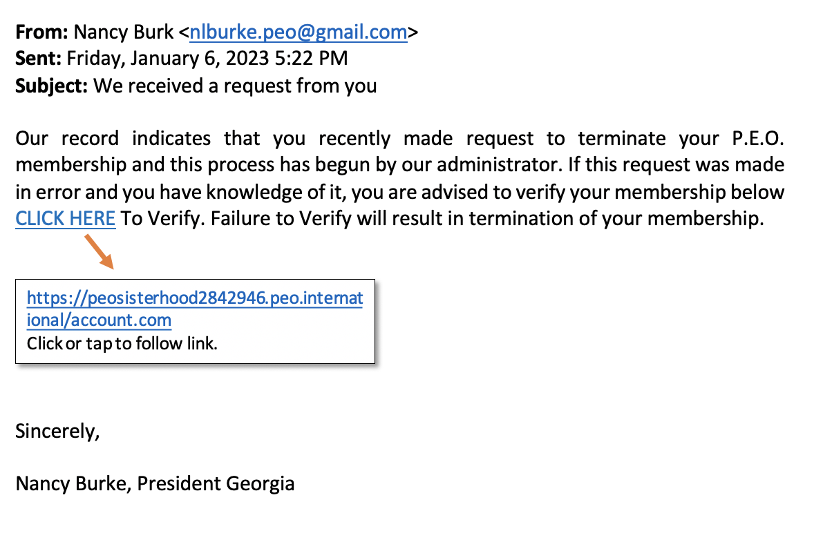
Example 1
7
Notes:
Find the errors. Take a minute to look over.
First of all, you can not terminate your P.E.O. membership. Those are unfamiliar words.
Nancy’s last name is spelled differently. Two have an “e” and one does not
Look at the URL or the link in the box: International is spelt with a “m” for “inteMATIONAL.”
The URL has “Peosisterhood with numbers”. I’ve never seen that. Have you? Exactly.
Contains poor grammar and typos such as “To Verify” which is capitalized in the middle of the sentence.

Slide 8
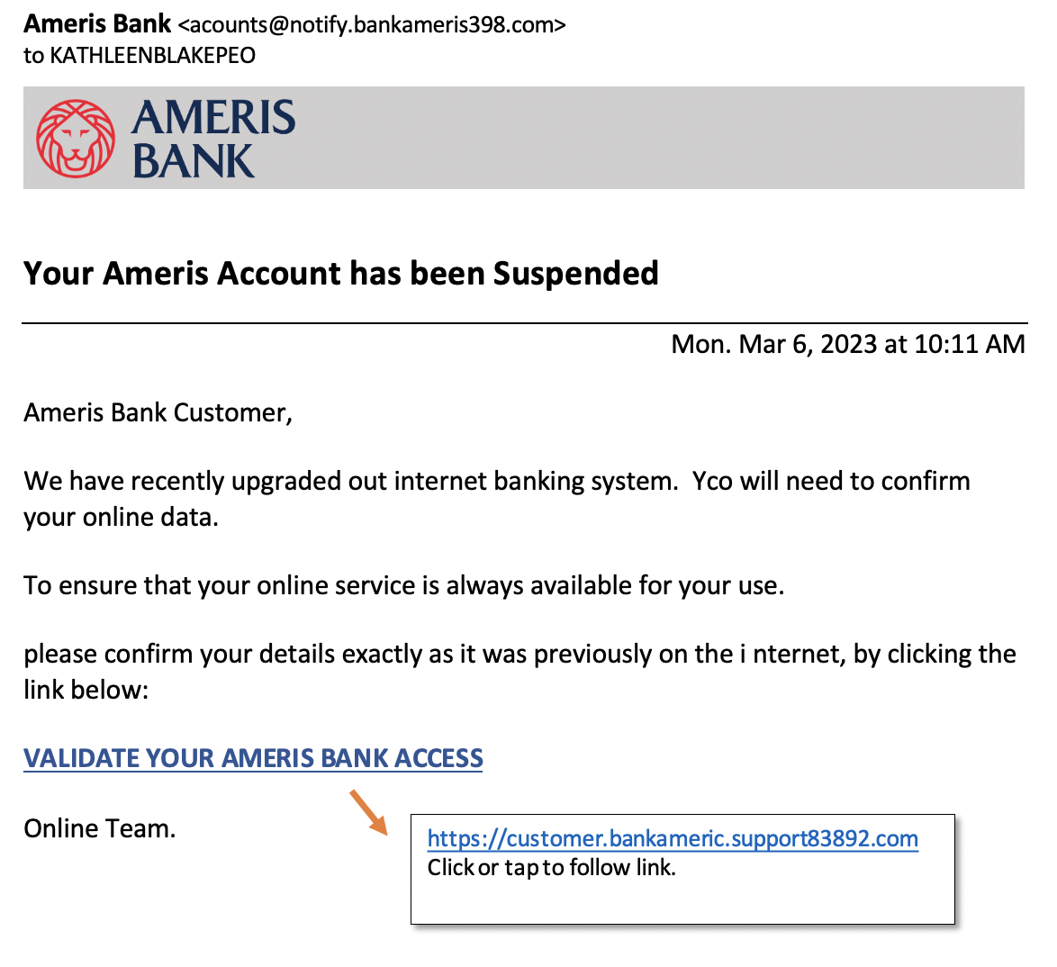
Example 2
8
Notes:
Find the errors:
I don’t bank at Ameris Bank. That is my first sign
Email address is not familiar and accounts is spelled incorrectly. It has only one “c”.
Spelling, grammatical and formatting errors. “You” is spelled “YCO.” “Please” is not capitalized at the beginning of the sentence. The ‘I” in internet is separated
A bank would never ask you to verify confidential account information via email.
URL is unfamiliar/incorrect. Again, note the use of numbers in the url

Slide 9
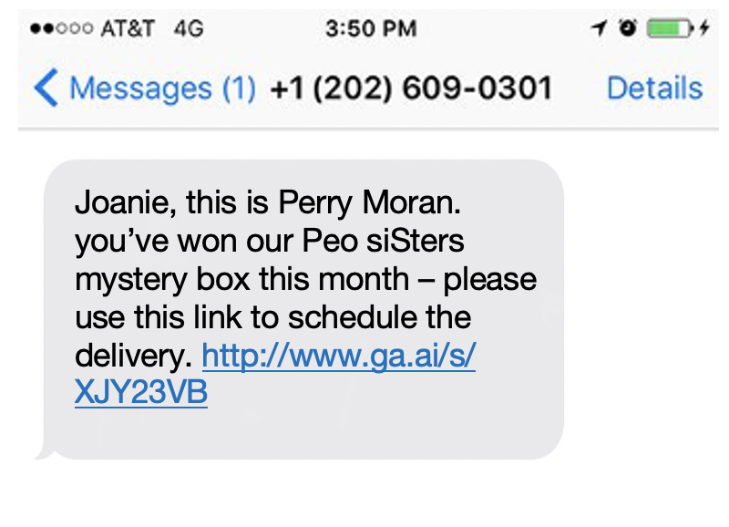
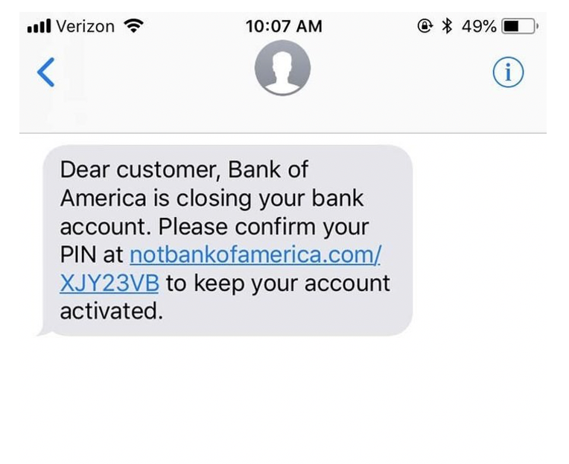
Example 3
9
Notes:
Find the errors. These are text messages.
Since I know Perry, I see that his last name is wrong
That is not Perry’s number.
Grammar and spelling errors: “siSters”
The link has an “a i” in it. That is for artificial intelligence
P.E.O. never gives anything away for free. Well, if you were the first hundreds to register for CIC in 2021, they did, but not usually. It is noted in our RECORD when it will happen
URL is unfamiliar/incorrect. Note “NOTbankofamerica.”
Bank will never ask for confidential information via text.

Slide 10
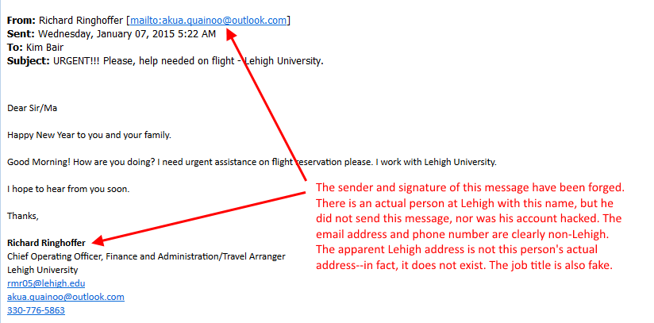
Example 4
10
Notes:
Find the errors. This is an example of clone phishing.
Richard’s email is completely different than what one would expect. “Mail to: akua.....”
Note the subject matter: URGENT!!! Please, help needed on flight.
Dear Sir/Ma. No one addresses Sir/Ma’am as Ma.
Email address is different than what a university would use. .edu versus @outlook.com

Slide 11
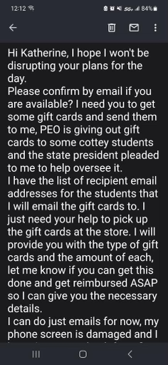
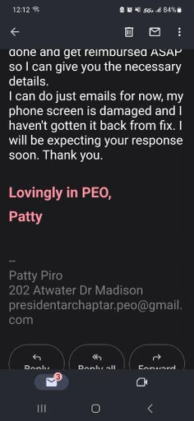
Example 5
11
Notes:
This is a screenshot of an email that was sent. Thank you Patty for allowing us to use this as an example. Sisters, please note that this email was not sent to just one sister in Patty’s chapter. Many of you received this or a similar email in March from your own supposed chapter president. This slide is not inserted to make anyone feel guilty or embarrassed. It is here to bring light to how hackers work; how they play on our emotions with powerful repercussions of self doubt, self worth and pure embarrassment, for allowing this to happen to us. So let’s look at this.
”Please confirm by email”
I need for you to get gift cards and send them to me”
“P.E.O. is giving out gift cards to some cottey students”
Reference to the state president
“It’s needed ASAP”
Signed by Patty and her address is given
This seems, on the surface to be legitimate. It uses terms that we know...Lovingly in PEO and Cottey students, although we spell Cottey with a capital C. As busy as we are, almost all of us would have just said, “Well, if Patty is asking, she must need it”, and go get the cards that she is requesting. When you look deeper, you will see that:
Patty does not live at this address anymore.
The gmail address is incorrect. It spells chapter as “chaptar” and what is “presidentA-Rchapter”? Please know though, if you are like most of us, you would not have given this a second look..
It is important to note here that even though this makes us feel like we need to do this immediately to help, chapter expenses are voted upon AT our meetings so this urgent request would not have been from Patty. When in doubt, pick up the phone and call someone to verify this request before acting upon it.

Slide 12




Phishing
Make sure the email is from a recognized sender by hovering over the email addresses/links.
Only open attachments or click on links from a trusted source.
When in doubt—
do not open, do not forward, and do not respond—
ask for help from the AL P.E.O. Tech Chair or your Board Buddy.
12
Notes:
Let’s recap… READ SLIDE
Be on the lookout for notices from your computer about possible phishing. Some computers will put a large box across your screen and note that this MAY be phishing so proceed with caution. Double check that the email looks right, that the grammar works, that there are no suspicious links to open. International will send emails with embedded links on occasion as a convenience for us but will NEVER ask for donations,, verifications of membership, or validation of passwords through a link. Lastly, be on the lookout for incorrect websites. They are very easy to “misread” so always double check the site before clicking. If you receive any suspicious communications, as we talked about earlier, immediately report to your Board Buddy or any Executive Board officer.

Slide 13
Questions?
THANK
YOU!
13
Notes:
We hope that this workshop has presented information that has opened your eyes to cyber safety. It is always changing and unfortunately we live in a world where malicious cyber attacks happen to all of us. Our sisterhood is no different but we hope that you will have heard and seen ways to navigate this world and be able to protect ourselves a little better. The Board plans to have this workshop posted on our Alabama website for use as a program that can be shown in your chapter. Please be sure to reach out to us if you need help with it. We are always here for each of you. Questions?

